Slide 1
Vertical Slice Architecture

Slide 3

Andoni Santamaría
Developer en Plainconcepts
Desarrollador de software y padre a tiempo completo.
Me gusta afrontar cualquier reto y encontrar una solución con la que me pueda sentir satisfecho, la zona de confort no es mi lugar habitual.
Me considero más backender pero desarrollo cosas decentes en front. Eso sí, no me pidas que combine colores.
#tardeo #cervezeo #colegueo #ps5 #athletic
@AndoniSantamari
asantamaria@plainconcepts.com

Slide 4

Special thanks to Jimmy Bogard

Slide 5
Introduction

Slide 6
Traditional n-tier
UI Layer
Business Logic Layer
Data Access Layer
Database

Slide 7
“DDD”-style n-tier
UI Layer
Services
Domain
Repository

Slide 8

Uncle Bob’s Clean Architecture
The primary purpose of architecture is to support the life cycle of the system.
Good architecture makes the system easy to understand, easy to develop, easy to maintain, and easy to deploy.
The ultimate goal is to minimize the lifetime cost of the system and to maximize programmer productivity.

Slide 9
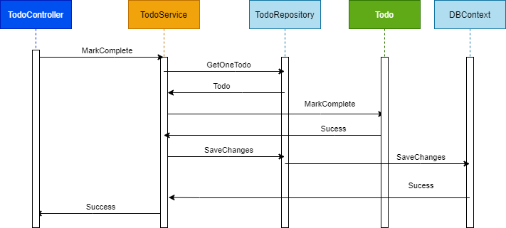
Sequence diagram example

Slide 10
Problems
Difficult for new developers to enter
Difficult to move to other solution
Side effects / coupling
Difficult to maintain
Heavy testing behaviours / mocks everywhere
¿SOLID?

Slide 11
Vertical Slices

Slide 12
Axes of change
UI Layer
View Todos
Remove Todo
Add Todo
Domain Objects
Repository
Database

Slide 13
Move code to single place

Slide 14
Move service methods to classes
Todo Service
void MarkComplete()
MarkCompleteTodo{}
void Delete()
DeleteTodo {}
void Update()
UpdateTodo {}

Slide 15
Modeling requests
Input
Request Handler
Output

Slide 16
Commands and Queries
Safe
Idempotent
Web App
GET
Query
Query
Handler
Response
Unsafe
Not Idempotent
POST
Command
Command
Handler
Response

Slide 17
One model in, one model out
Query
Handler
Response
Command
Handler
Response

Slide 18
Complete encapsulation
Request
Response

Slide 19
Queries

Slide 20
Modeling Queries
Query
Handler
Response

Slide 21
Queries
public class GetTodo
{
public record Query(string TodoId) : IQuery<Response>;
}

Slide 22
Pagination Data
public record Query() : IQuery<Response>
{
public int Offset { get; set; } = 0;
public int Limit { get; set; } = 10;
public string OrderBy { get; set; } = string.Empty;
public OrderType OrderType { get; set; } = OrderType.Asc;
}

Slide 23
Modeling Responses
Query
Handler
Response
View

Slide 24
Response
public class GetTodos
{
public record Query() : IQuery<PaginatedResponse>;
public record PaginatedResponse()
{
public int Pages { get; set; }
public Response[] Elements { get; set; } = Array.Empty<Response>();
}
public record Response(string Id, string Caption, bool IsCompleted);
}

Slide 25
Modeling Query Handlers
Query
Handler
Response

Slide 26

NO MINIMAL ABSTRACTIONS ARCHITECTURE

Slide 27
Handler
public class RequestHandler : IRequestHandler<Query, Response>
{
…
public async Task<Response> Handle(Query request, CancellationToken cancellationToken = default)
{ return await _context.Todos
.AsNoTracking()
.Where(t => t.Id == request.TodoId)
.Select(td => new Response(td.Id, td.Title, td.Completed))
.SingleOrDefaultAsync(cancellationToken);
}
}
}

Slide 28
Encapsulated Logic
Query
ORM
Response
Query
MicroORM
Response
Query
HttpClient
Response
Query
ORM Read Only
Response

Slide 29
Commands

Slide 30
Void Response
Command
Handler
IRequest

Slide 31
Commands
public class CreateTodo
{
public record Command(string Title) : ICommand;
}

Slide 32
Success/Fail
Command
Handler
true/
false
ICommand<bool>

Slide 33
Creation
Create
Handler
Id
ICommand<Guid>
302 Found
/orders/1

Slide 34
Task-Based UIs
Complete
Request
Handler
Response
Todo Details
Complete
Update
Delete
…
…
…
…
…
…
…
Update
Request
Handler
Response
Delete
Request
Handler
Response

Slide 35
Validation

Slide 36
Validation Scopes
Command Validation
Domain Model
Request Validation
Request
Database
External Models

Slide 37
Request Validation
public class Validator : AbstractValidator<Command>
{
public Validator()
{
RuleFor(r => r.Id).NotEmpty();
RuleFor(r => r.Title).NotEmpty();
}
}

Slide 38
Domain Validation
Request
Handler
Domain + Validation
Response

Slide 39
Feature Module
public class GetTodo : IFeatureModule
{
public void AddRoutes(IEndpointRouteBuilder app){…}
public record Query(string TodoId) : IQuery<Response>;
public record Response(string Id, string Caption, bool IsCompleted);
public class RequestHandler : IRequestHandler<Query, Response>){…}
public class RequestValidator : AbstractValidator<Query>){…}
}

Slide 40

SHOW ME THE CODE

Slide 41
Complexity

Slide 42
Request
Request
Push Behavior Down
Extracting Domain Services
Encapsulating Data
Encapsulating Collections
Handler
REFACTOR
Handler
Domain
Domain
Response
Response

Slide 43

REFACTOR TIME ‘DDD’

Slide 44
Duplication

Slide 45
Cross-Cutting Concerns
Duplication
Request
Handler
Response

Slide 46
Pipeline Behavior (Decorator)
Pipeline Behavior
Request
Handler
Response

Slide 47
Stackable Decorators
Pipeline Behavior
Pipeline Behavior
Pipeline Behavior
Handler

Slide 48
Logging
public class LoggingBehavior<TRequest, TResponse> : IPipelineBehavior<TRequest, TResponse>
where TRequest : IRequest<TResponse>
{
private readonly ILogger<TRequest> _logger;
public LoggingBehavior(ILogger<TRequest> logger)
{
_logger = logger;
}
public async Task<TResponse> Handle(TRequest request, CancellationToken cancellationToken,
RequestHandlerDelegate<TResponse> next)
{
_logger.LogInformation($"Handling {typeof(TRequest).Name}");
var response = await next();
_logger.LogInformation($"Handled {typeof(TResponse).Name}");
return response;
}
}

Slide 49
Transactions Concurrency and Retries Time Elapsed Logging Validation Unit of Work ….

Slide 50
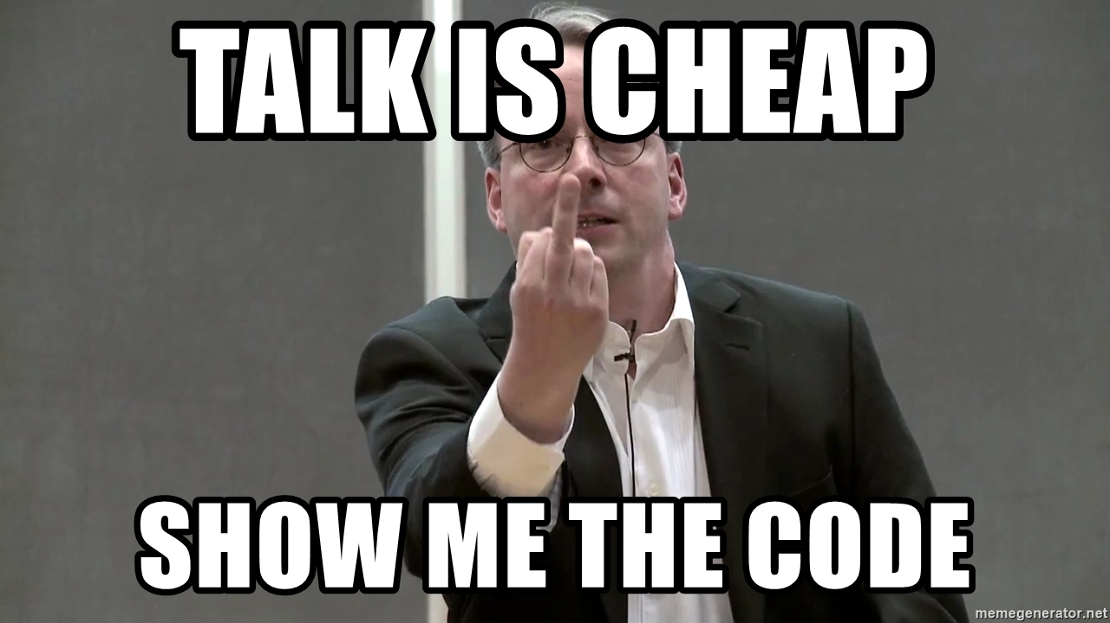
Caching

Slide 51
Events & Integrations

Slide 52
Notifications with MediatR
INotificationHandler
INotification
Mediator Publish
INotificationHandler
INotificationHandler

Slide 53
More decoupling
public class TodoCompletedEvent : INotification
{
public Todo Todo { get; }
public TodoCompletedEvent(Todo todo)
{
Todo = todo;
}
}
await _mediator.Publish(new TodoCompletedEvent(todo));
public class TodoCompletedEventHandler : INotificationHandler<TodoCompletedEvent> {…}

Slide 54
Domain events vs integration events Outbox pattern -> no orchestration
SAME TRANSACTION – SAME LIFETIME COMMAND
Event
Persistence
Worker
Integration Event
Publish

Slide 55

SHOW ME THE CODE

Slide 56
Testing

Slide 57
Act
Arrange
API
Assert
Pipeline Behavior
Pipeline Behavior
Request
Handler
Response

Slide 58
Unit and Integration Tests (Reproduce Reality)
API
Pipeline Behavior
Pipeline Behavior
Integration Tests
Handler
Unit Tests
Domain Model

Slide 59
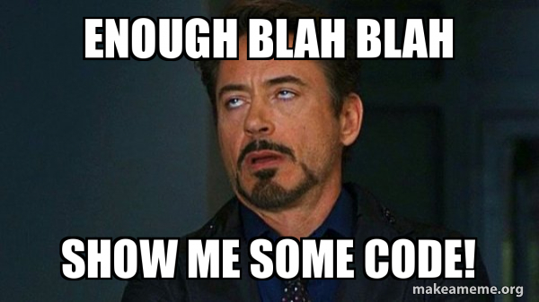
SHOW ME THE CODE

Slide 60
Summary
Vertical slices makes code easy to add/change/delete
Easy to move to another solution/host
No side effects
Do not skip refactor! , push behavior down
Integration test handlers/api, unit test domain
Make any architecture YOURS

Slide 61
Questions & Answers

Slide 62


